Slide 1
UPPER SIXTH ARTS
GEOGRAPHY
Lesson 13
Migration: Characteristics, Laws and Models
Notes:
Good morning, class, and welcome to our geography lesson. I am your geography teacher, Mr Kamdem. Today we are starting Lesson 13: Migration: Characteristics, Laws and Models.

Slide 2
CLASS INFO
Class, Chapter and Duration
Class | Upper Sixth Arts
Chapter | Module 4: Understanding and managing population dynamics across the world in general and Cameroon in particular
Duration | 2 periods (2 × 50 minutes)
Notes:
This lesson is for Upper Sixth Arts. It belongs to Module 4: Understanding and managing population dynamics across the world in general and Cameroon in particular. We shall need 2 periods to cover it.

Slide 3
IDENTIFICATION
Lesson Identification
Topic | Population Change over Space (Migration)
Sub-topic | Migration Laws
Lesson | Lesson 13: Migration: Characteristics, Laws and Models
Notions / Concepts | Migration, selectivity, chain migration, brain drain, Zipf's inverse distance law, gravity model, Stouffer's intervening opportunities.
Syllabus focus | Meaning and characteristics (differentials) of migration: age, sex, skills, marital status, ethnic group; laws and models: Zipf, gravity model, Stouffer; calculations.
Competence | Learners are able to explain who migrates and to use the migration models to predict flows between towns.
Notes:
Our topic is Population Change over Space (Migration), and the sub-topic is Migration Laws. The key notions we shall use today are: migration, selectivity, chain migration, brain drain, Zipf's inverse distance law, gravity model, Stouffer's intervening opportunities. At the end, you should be able to do this: learners are able to explain who migrates and to use the migration models to predict flows between towns.

Slide 4

HOMEWORK CORRECTION
Correction of the Homework
Question (Lesson 12: The Demographic Transition Model):
Define migration.
Notes:
Before we start the new lesson, let us correct the homework I gave you at the end of Lesson 12: The Demographic Transition Model. The question was: Define migration. Take out your exercise books.

Slide 5
HOMEWORK CORRECTION
Correction: Possible Answer
Migration is the movement of people from one place to another to settle there, temporarily or permanently.
Notes:
Here is a good answer. Migration is the movement of people from one place to another to settle there, temporarily or permanently. Compare it with your own answer and correct your work in red.

Slide 6
LESSON PLAN
Lesson Plan
Correction of the homework
Objectives and recall
Real-life situation and action to take
Learning activities
Board summary
Evaluation, remediation and homework
Notes:
Here is the plan of our lesson today. First, we shall correct the homework. Then we shall look at the objectives and recall what you already know. After that, we shall study a situation from real life and the action to take, and do the learning activities. Finally, we shall copy the board summary, do the evaluation and the remediation, and I will give you the homework.

Slide 7
OBJECTIVES
Objectives
By the end of this lesson, you should be able to:
Define migration.
Explain the selectivity of migration.
Explain Zipf's inverse distance law.
Explain and apply the gravity model.
Notes:
Take your time to copy this part; we will continue together.

Slide 8
OBJECTIVES
Objectives (continued)
Explain and apply Stouffer's model of intervening opportunities.
Notes:
By the end of this lesson, you should be able to do five things. Number 1: define migration. Number 2: explain the selectivity of migration. Number 3: explain Zipf's inverse distance law. Number 4: explain and apply the gravity model. Number 5: explain and apply Stouffer's model of intervening opportunities.

Slide 9
PREVIOUS KNOWLEDGE
Previous Knowledge
Push factors drive people out; pull factors attract them.
Young adults move more than old people.
Douala is the largest town of Cameroon.
Notes:
Let us first remember what you already know. Push factors drive people out; pull factors attract them. Young adults move more than old people. Douala is the largest town of Cameroon. Keep this in mind, because we shall build on it today.

Slide 10
REAL-LIFE SITUATION
Situation in Real Life
Ibrahim has two cousins from a village near Pitoa who have just finished secondary school.
Ali moved to Ngaoundéré to attend university because it is near and the bus ticket is cheap.
Notes:
Take your time to copy this part; we will continue together.

Slide 11
REAL-LIFE SITUATION
Situation in Real Life (continued)
Fatima, who is very ambitious, went all the way to Douala to look for a well-paid job in a big company, a much longer and costlier journey.
Ibrahim asks: "Who usually migrates, and why do some people choose a nearby town while others go very far?"
Notes:
Listen carefully to this situation from real life. Ibrahim has two cousins from a village near Pitoa who have just finished secondary school. Ali moved to Ngaoundéré to attend university because it is near and the bus ticket is cheap. Fatima, who is very ambitious, went all the way to Douala to look for a well-paid job in a big company, a much longer and costlier journey. Ibrahim asks: "Who usually migrates, and why do some people choose a nearby town while others go very far?" Think about it, because I am going to ask you some questions.

Slide 12
REAL-LIFE SITUATION
Situation: Question 1
What is the problem in the situation?
Notes:
Question 1: What is the problem in the situation? Think for a moment, then raise your hand to answer.

Slide 13
REAL-LIFE SITUATION
Answer
Ibrahim does not know the characteristics of migrants and the laws that explain their choices.
Notes:
Good. Ibrahim does not know the characteristics of migrants and the laws that explain their choices.

Slide 14
REAL-LIFE SITUATION
Situation: Question 2
What did Ali and Fatima both do?
Notes:
Question 2: What did Ali and Fatima both do? Think for a moment, then raise your hand to answer.

Slide 15
REAL-LIFE SITUATION
Answer
They migrated: they moved to a new place to settle there.
Notes:
Good. They migrated: they moved to a new place to settle there.

Slide 16
REAL-LIFE SITUATION
Situation: Question 3
Why did Fatima choose far-away Douala?
Notes:
Question 3: Why did Fatima choose far-away Douala? Think for a moment, then raise your hand to answer.

Slide 17
REAL-LIFE SITUATION
Possible Answer
It is a very big city with many more opportunities.
Notes:
Good. It is a very big city with many more opportunities.

Slide 18
ACTION TO TAKE
Action to Take
Compare distance and opportunities before deciding where to study or work.
Notes:
From this situation, the action we are working towards in this lesson is the following: compare distance and opportunities before deciding where to study or work.

Slide 19
JUSTIFICATION
Justification of the Lesson
This lesson helps us to understand and predict migration flows, which are needed to plan transport, housing and jobs.
Notes:
Why is this lesson important for you? This lesson helps us to understand and predict migration flows, which are needed to plan transport, housing and jobs.

Slide 20
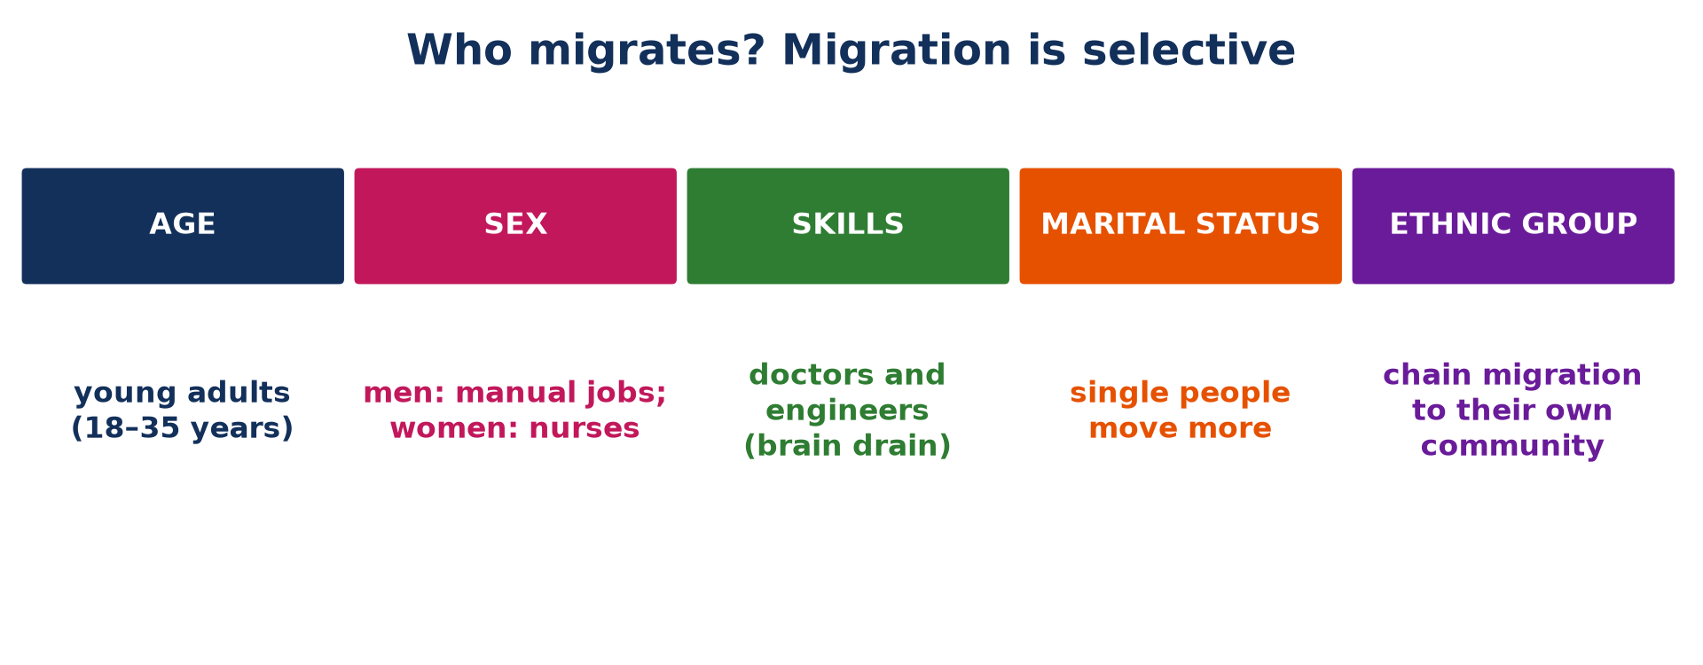
1. CHARACTERISTICS
Activity 1
Who migrates?
Notes:
Activity 1. Look carefully at this picture: who migrates?. Observe every detail before I ask the question.

Slide 21
1. CHARACTERISTICS
Activity 1: Question
Which age group migrates most?
Notes:
Here is the question for Activity 1: Which age group migrates most? Take one minute to think and write your answer in your rough notebook.

Slide 22
1. CHARACTERISTICS
Activity 1: Answer
Young adults of about 18 to 35 years.
Notes:
Let us check the answer together. Young adults of about 18 to 35 years.

Slide 23
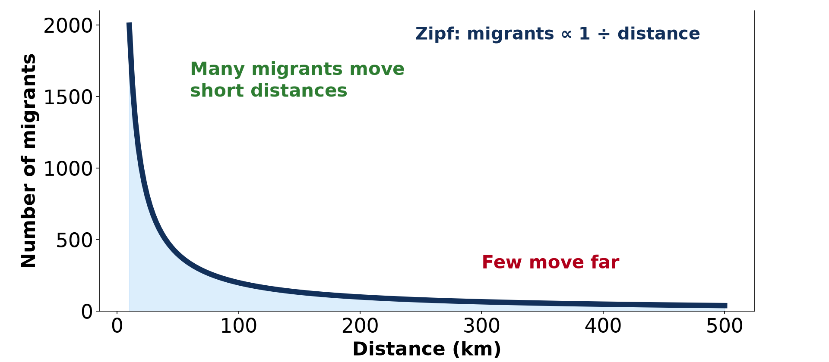
2. ZIPF
Activity 2
Migrants and distance.
Notes:
Activity 2. Look carefully at this diagram: migrants and distance. Observe every detail before I ask the question.

Slide 24
2. ZIPF
Activity 2: Question
According to Zipf, what happens to the number of migrants as distance increases?
Notes:
Here is the question for Activity 2: According to Zipf, what happens to the number of migrants as distance increases? Take one minute to think and write your answer in your rough notebook.

Slide 25
2. ZIPF
Activity 2: Answer
It decreases.
Notes:
Let us check the answer together. It decreases.

Slide 26
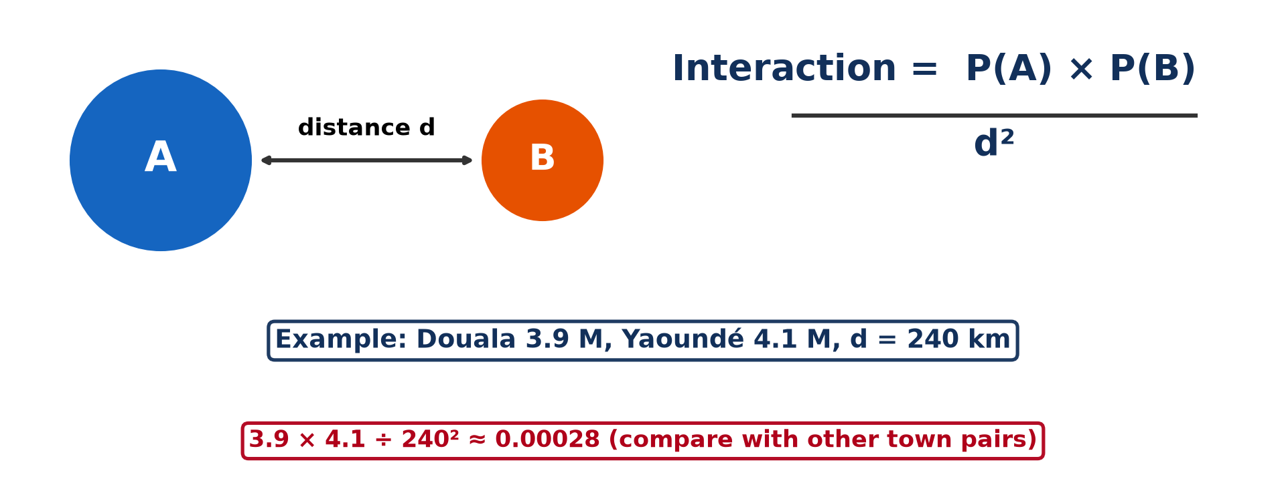
2. GRAVITY MODEL
Activity 3
The gravity model.
Notes:
Activity 3. Look carefully at this diagram: the gravity model. Observe every detail before I ask the question.

Slide 27
2. GRAVITY MODEL
Activity 3: Question
Why does Douala attract migrants from far away?
Notes:
Here is the question for Activity 3: Why does Douala attract migrants from far away? Take one minute to think and write your answer in your rough notebook.

Slide 28
2. GRAVITY MODEL
Activity 3: Answer
Its very large population gives it a strong "pull".
Notes:
Let us check the answer together. Its very large population gives it a strong "pull".

Slide 29
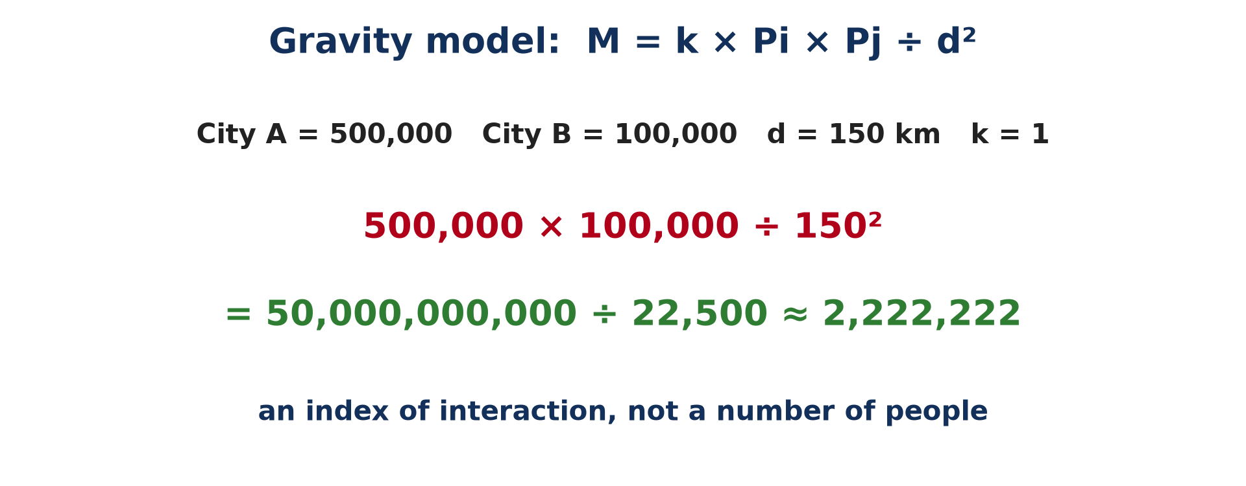
3. CALCULATION
Activity 4
A worked example.
Notes:
Activity 4. Look carefully at this picture: a worked example. Observe every detail before I ask the question.

Slide 30
3. CALCULATION
Activity 4: Question
City Y has 1,000,000 people, City Z 2,000,000, and they are 200 km apart. Calculate the interaction (k = 1).
Notes:
Here is the question for Activity 4: City Y has 1,000,000 people, City Z 2,000,000, and they are 200 km apart. Calculate the interaction (k = 1). Take one minute to think and write your answer in your rough notebook.

Slide 31
3. CALCULATION
Activity 4: Answer
1,000,000 × 2,000,000 ÷ 200² = 50,000,000.
Notes:
Let us check the answer together. 1,000,000 × 2,000,000 ÷ 200² = 50,000,000.

Slide 32
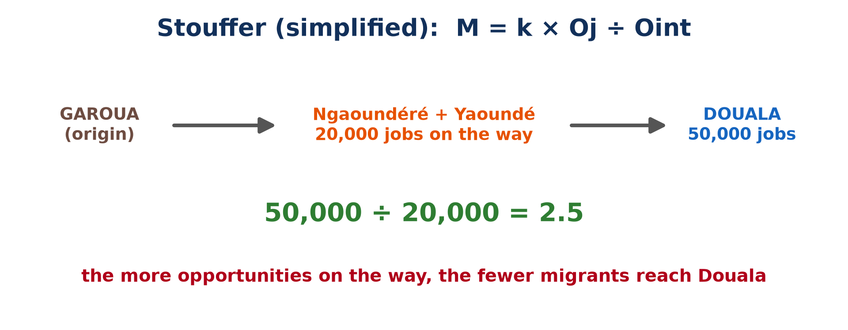
3. STOUFFER
Activity 5
Intervening opportunities.
Notes:
Activity 5. Look carefully at this picture: intervening opportunities. Observe every detail before I ask the question.

Slide 33
3. STOUFFER
Activity 5: Question
Why may a migrant from Garoua stop in Ngaoundéré instead of going to Douala?
Notes:
Here is the question for Activity 5: Why may a migrant from Garoua stop in Ngaoundéré instead of going to Douala? Take one minute to think and write your answer in your rough notebook.

Slide 34
3. STOUFFER
Activity 5: Answer
Ngaoundéré offers an intervening opportunity on the way.
Notes:
Let us check the answer together. Ngaoundéré offers an intervening opportunity on the way.

Slide 35
BOARD SUMMARY
Board Summary
Topic: Population Change over Space (Migration)
Sub-topic: Migration Laws
Lesson 13: Migration: Characteristics, Laws and Models
Notes:
Now we are going to copy the board summary. Write the title and the headings neatly in your notebooks. I will give you enough time for each slide, so do not rush.

Slide 36
BOARD SUMMARY
DEFINITIONS
The key terms of this lesson are defined as follows:
Migration: It is the movement of people from an origin to a destination with the intention of settling there, temporarily or permanently.
Notes:
Let us copy the definitions. The key terms of this lesson are defined as follows. On this slide we have Migration. Write each point on a new line, with the key term first, and explain it in your own words when we revise. When you finish, we go to the next slide.

Slide 37
BOARD SUMMARY
DEFINITIONS (continued)
Selectivity of migration: It is the fact that people with certain characteristics (age, sex, skills) migrate more than others.
Laws of migration: They are general rules that describe and predict the volume and direction of migration.
Notes:
We continue with the definitions. On this slide we have Selectivity of migration and Laws of migration. Write each point on a new line, with the key term first, and explain it in your own words when we revise. When you finish, we go to the next slide.

Slide 38
BOARD SUMMARY
DEFINITIONS (continued)
Intervening opportunity: It is an opportunity found between the origin and the destination that reduces the flow to the destination.
Notes:
We continue with the definitions. On this slide we have Intervening opportunity. Write each point on a new line, with the key term first, and explain it in your own words when we revise.

Slide 39
BOARD SUMMARY
1. Meaning and Volume of Migration
Migration and its volume are explained as follows:
Meaning: Migration is a change of residence from one place to another, inside a country or across a border. Short trips, such as visits or commuting, are not migration because people do not change their home.
Notes:
Let us copy Meaning and Volume of Migration. Migration and its volume are explained as follows. Copy the point on Meaning: write the key term first, then its explanation.

Slide 40
BOARD SUMMARY
1. Meaning and Volume of Migration
Volume of migration: The volume is the number of people who move between two places in a given period. It is large when the differences in jobs and wages between places are great and when the obstacles, such as distance and borders, are small.
Notes:
We continue with Meaning and Volume of Migration. Copy the point on Volume of migration: write the key term first, then its explanation.

Slide 41
BOARD SUMMARY
2. Characteristics (Differentials) of Migration
Migrants are selected by the following characteristics:
Age: Young adults of 18 to 35 years migrate most, for studies and first jobs. They also have few family responsibilities.
Illustration: the selectivity of migration
Notes:
Let us copy Characteristics (Differentials) of Migration. Migrants are selected by the following characteristics. Copy the point on Age on the left, then draw the diagram on the right: the selectivity of migration. Give it a title and label it clearly.

Slide 42
BOARD SUMMARY
2. Characteristics (Differentials) of Migration
Sex: Men often migrate for manual work, as South Asian workers in the Gulf countries. Many women migrate as professionals, like Filipino nurses in the United Kingdom and Canada.
Notes:
We continue with Characteristics (Differentials) of Migration. Copy the point on Sex: write the key term first, then its explanation.

Slide 43
BOARD SUMMARY
2. Characteristics (Differentials) of Migration
Skills and education: Doctors and engineers leave poor countries for rich ones, which is called brain drain. Unskilled workers fill jobs in farming and building.
Notes:
We continue with Characteristics (Differentials) of Migration. Copy the point on Skills and education: write the key term first, then its explanation.

Slide 44
BOARD SUMMARY
2. Characteristics (Differentials) of Migration
Marital status and group: Single people move more easily than married people with children. People also follow members of their own community, which is called chain migration, like the Turks in Germany.
Notes:
We continue with Characteristics (Differentials) of Migration. Copy the point on Marital status and group: write the key term first, then its explanation.

Slide 45
BOARD SUMMARY
3. Laws and Theories of Migration
A) Zipf's Law and the Gravity Model
Distance and size explain migration in the following models:
Zipf's inverse distance law: The number of migrants between two places is inversely proportional to the distance between them: M ∝ 1 ÷ d. Many people move short distances, and few move far.
Illustration: Zipf's law
Notes:
Let us copy Zipf's Law and the Gravity Model. Distance and size explain migration in the following models. Copy the point on Zipf's inverse distance law on the left, then draw the diagram on the right: zipf's law. Give it a title and label it clearly.

Slide 46
BOARD SUMMARY
3. Laws and Theories of Migration
A) Zipf's Law and the Gravity Model
The gravity model: Migration between two places is proportional to the product of their populations and inversely proportional to the square of the distance: M = k × Pi × Pj ÷ d². Large cities therefore exert a strong pull, even from far away, as Douala does on the whole country.
Illustration: the gravity model
Notes:
Copy the point on The gravity model on the left, then draw the diagram on the right: the gravity model. Give it a title and label it clearly.

Slide 47
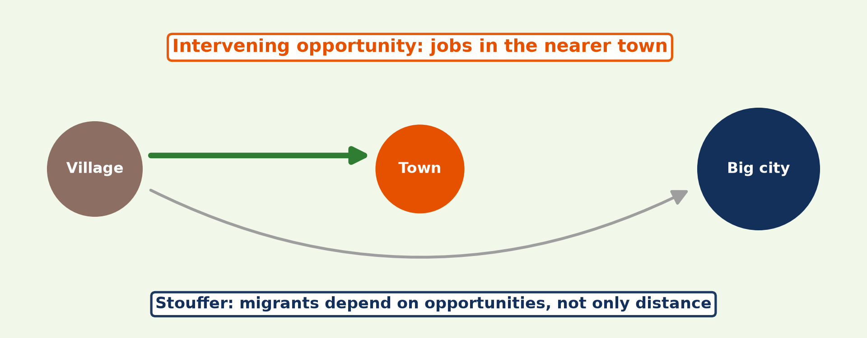
BOARD SUMMARY
3. Laws and Theories of Migration
B) Stouffer's Intervening Opportunities Model
Stouffer's model explains migration as follows:
Principle: The number of migrants depends less on distance than on the opportunities found on the way. An opportunity between the origin and the destination can stop the migrant before he arrives.
Illustration: Stouffer's model
Notes:
Let us copy Stouffer's Intervening Opportunities Model. Stouffer's model explains migration as follows. Copy the point on Principle on the left, then draw the diagram on the right: stouffer's model. Give it a title and label it clearly.

Slide 48
BOARD SUMMARY
3. Laws and Theories of Migration
B) Stouffer's Intervening Opportunities Model
Formula and example: In a simplified form, M = k × Oj ÷ Oint, where Oj is the opportunities at the destination and Oint the opportunities on the way. For example, a migrant from Garoua may settle in Ngaoundéré or Yaoundé instead of continuing to Douala.
Notes:
We continue with Stouffer's Intervening Opportunities Model. Copy the point on Formula and example: write the key term first, then its explanation.

Slide 49
BOARD SUMMARY
4. Calculations Based on the Models
The models are applied as in the following examples:
Gravity model: City A has 500,000 people and City B 100,000, and they are 150 km apart, with k = 1. The interaction is 500,000 × 100,000 ÷ 150² ≈ 2,222,222, an index used to compare pairs of towns and not a number of people.
Illustration: a gravity calculation
Notes:
Let us copy Calculations Based on the Models. The models are applied as in the following examples. Copy the point on Gravity model on the left, then draw the diagram on the right: a gravity calculation. Give it a title and label it clearly.

Slide 50
BOARD SUMMARY
4. Calculations Based on the Models
Stouffer's model: Douala offers 50,000 jobs and the towns on the way offer 20,000, so the ratio is 50,000 ÷ 20,000 = 2.5. A ratio above 1 shows that the final destination pulls more strongly than the towns on the way.
Illustration: a Stouffer calculation
Notes:
Copy the point on Stouffer's model on the left, then draw the diagram on the right: a Stouffer calculation. Give it a title and label it clearly.

Slide 51
FORMATIVE EVALUATION
Evaluation 1
Give two characteristics of migrants.
Notes:
Now let us check what you have understood. Question 1: Give two characteristics of migrants. Answer in your exercise book.

Slide 52
FORMATIVE EVALUATION
Expected Answer
They are mostly young adults, often single, and skilled people migrate more (brain drain) (any two).
Notes:
The expected answer is: they are mostly young adults, often single, and skilled people migrate more (brain drain) (any two). If you got it right, well done.

Slide 53
FORMATIVE EVALUATION
Evaluation 2
State the main difference between the gravity model and Stouffer's model.
Notes:
Now let us check what you have understood. Question 2: State the main difference between the gravity model and Stouffer's model. Answer in your exercise book.

Slide 54
FORMATIVE EVALUATION
Expected Answer
The gravity model uses population and distance; Stouffer uses the opportunities at the destination and on the way.
Notes:
The expected answer is: the gravity model uses population and distance; Stouffer uses the opportunities at the destination and on the way. If you got it right, well done.

Slide 55
REMEDIATION
Remediation
Fill in the blanks:
Zipf's law says that migration decreases with ______.
In the gravity model, distance is ______.
Stouffer speaks of ______ opportunities.
Notes:
For those who need more practice, fill in the blanks in your exercise book. The answers are: number 1, distance; number 2, squared; number 3, intervening.

Slide 56
HOMEWORK
Homework
Define spatial interaction.
Notes:
For your homework: Define spatial interaction. We shall correct it at the beginning of our next lesson.

Slide 57
NEXT LESSON
Next Lesson
Our next lesson will be on:
Lesson 14: Spatial Interaction
Notes:
Our next lesson will be on Lesson 14: Spatial Interaction. Thank you for your attention, and see you next time.

Slide 58
BILINGUAL GAME
Bilingual Game (Jeu Bilingue)
English | Français
Migration | La migration
Distance | La distance
Gravity model | Le modèle gravitaire
Intervening opportunity | L'opportunité intermédiaire
Brain drain | La fuite des cerveaux
Chain migration | La migration en chaîne
Notes:
Let us play the bilingual game. I say a word in English, and you give me the French word. Then we do the reverse.

Slide 59
LOGBOOK
Official Logbook (1/2)
Module / Topic | Population Change over Space (Migration)
Lesson Title | Lesson 13: Migration: Characteristics, Laws and Models
Expected Learning Outcomes | Define migration. Explain the selectivity of migration. Explain Zipf's inverse distance law. Explain and apply the gravity model. Explain and apply Stouffer's model of intervening opportunities.
Competence | Learners are able to explain who migrates and to use the migration models to predict flows between towns.
Notes:
I record this information in the official logbook of the class after the lesson.

Slide 60
LOGBOOK
Official Logbook (2/2)
Matter Taught | DEFINITIONS; Meaning and Volume of Migration; Characteristics (Differentials) of Migration; Zipf's Law and the Gravity Model; Stouffer's Intervening Opportunities Model; Calculations Based on the Models.
Evaluation | Formative evaluation and remediation exercise.
Homework | Define spatial interaction.
Enrolment / Present / Absent | ____ / ____ / ____
Achievement | To be completed after the lesson.
Notes:
I complete the second page of the logbook: the matter taught, the evaluation, the homework and the attendance.

Slide 61
TEACHER'S NOTE
Teacher's Note
Timing: Homework correction, plan, objectives 8 min | Recall, situation, action 10 min | 5 activities 30 min | Board summary (copying) 30 min | Evaluation, remediation 10 min | Homework, next lesson 5 min | Logbook 7 min
Without the projector (Activity 1): ask who in the class wants to study far from home.
Without the projector (Activity 2): draw the falling curve.
Without the projector (Activity 3): draw two circles and a line.
Without the projector (Activity 4): calculate on the board.
Without the projector (Activity 5): draw the route Garoua–Douala.
Notes:
This slide is for me, the teacher: it gives the timing of the lesson and what to do if the projector is not available.

Slide 62
REFERENCES
References
Geography Syllabus for Sixth Forms (Lower and Upper Sixth), MINESEC, 2019 — Module 4 (Population Geography).
Teacher's course notes: Mr KAMDEM E., Population Geography (USA), GBHS Garoua, 2026.
United Nations, World Population Prospects 2024.
Diagrams and animations: drawn for this lesson (Geography Department).
Notes:
These are the references and picture credits used to prepare this lesson.

